Slide 1
Rear Wing
Chella Thiyagarajan N
ME17B179

Slide 2
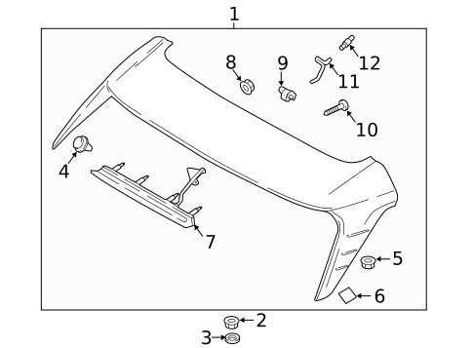
Objective
To create a rear wing to regulate airflow and deliver optimal downforce to enable higher corner speed of automobiles.

Slide 3
Working Methodology
Drag is the natural reaction of the fluid (air) to resist motion through it (the car)
wing is a device whose intended design is to generate downforce as air passes around it, not simply disrupt existing airflow patterns. As such, rather than decreasing drag, automotive wings actually increase drag.
To increase speed at corners we need to increase the weight of the car or have a rear wing
Increasing weight increases inertia which we have to overcome at the turn
Rear wing increases weight by providing down force

Slide 4
Deliverables
It improves grip of the car
High speeds at corners
The way the spoiler works is like an airplane wing, but upside down. The spoiler actually generates what's called 'down force' on the body of the car.
Rear wing in race cars increases downforce tremendously and increases corner speed but it also increases drag and tries to slow down the car in straights.

